Slide 1
It is all about perspective
Ms. Kaiser

Slide 2
What do you see?

Slide 3
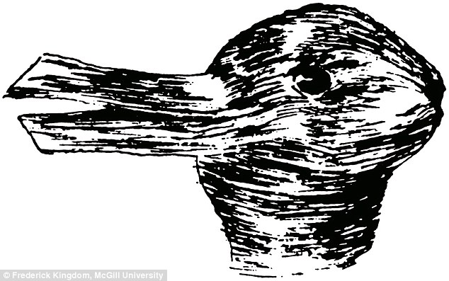
What do you see?

Slide 4
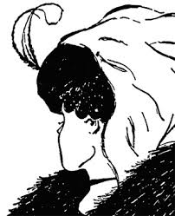
What do you see?

Slide 5
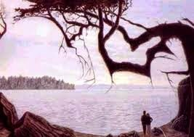
What do you See?

Slide 6
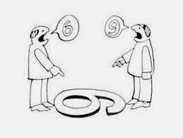
Who is right?

Slide 7
Perspective taking & conflict resolution
Some students saw different images than others.
When examining some of the pictures, it was challenging for students to see the image that other students were seeing and it took some explaining, focus, and time to figure it out.
Looking at these images was a great springboard for discussion on trying to see someone else’s point of view by opening up your mind, truly listening, and putting yourself in their shoes.
We talked about how our past experiences influence and shape the way we think.
In solving a conflict, we need to set aside our biases that we bring to the conflict and concentrate on the issue at hand

Slide 8
Perspective taking & conflict resolution
Students mentioned how hard it can be to do this because we usually think our way is the right way.
Not interrupting the other person and letting them share is also hard because you want to jump in and defend your way of thinking.
We talked about why it’s important to look at a situation from another perspective and how this can be helpful to our relationships with friends and family members.
A conflict will never be resolved as long as both parties are only looking at their side of the story.

Slide 9
video
https://www.youtube.com/watch?v=cTOhzcSYMlM
https://www.youtube.com/watch?v=GuT8maVSaOs

